Slide 1
Future Excavation Construction:
Machine Learning & Real-time Monitoring
Lucca Pereira Martins
Notes:
Good afternoon and welcome everyone,
Today, I’ll be looking at how we can use machine learning to improve excavation construction.
Let’s get straight into it.

Slide 2
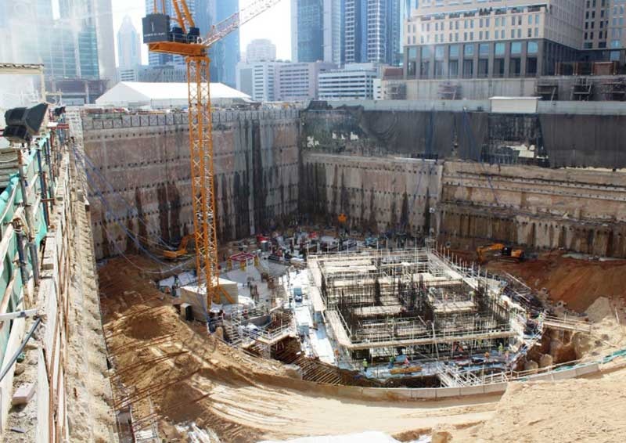
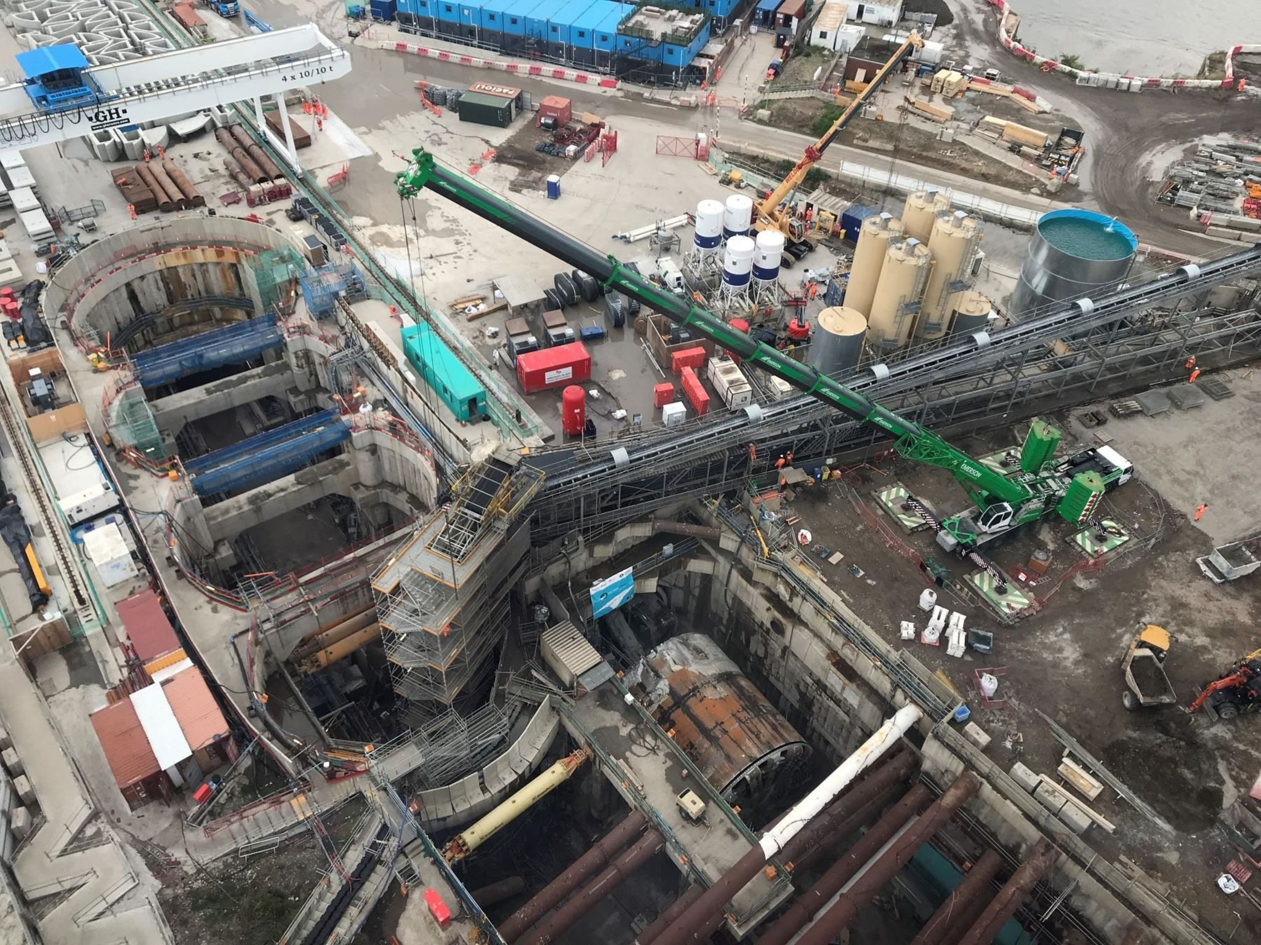
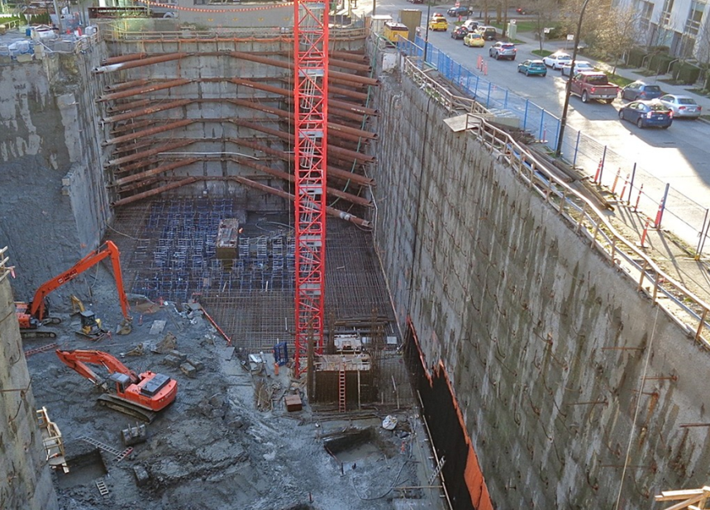
Introduction to Deep Excavations
Deep excavation > 4.5m depth
Skyscraper Foundations,
Dubai
Silvertown Tunnel,
London
Residential Development,
Mumbai
Source 1: https://www.geplus.co.uk/events/the-deepest-basement-in-dubai-18-08-2017/
Source 2: https://www.bbc.co.uk/news/uk-england-london-66393677
Source 3: https://fakhargroup.com/en/deep-excavation/
Notes:
What are deep excavations?
Simply put, any excavation which is more than 4.5m in depth.
We concern ourselves with much highly technical work and megaprojects such as:
Basements for skyscrapers
Underground transport infrastructure
Or urban developments
These are complex and risky projects which are becoming even more frequent in the centre of major cities.
Space is limited.
Building outwards is expensive, building upwards is expensive and challenging, so building downwards is the next best thing.

Slide 3
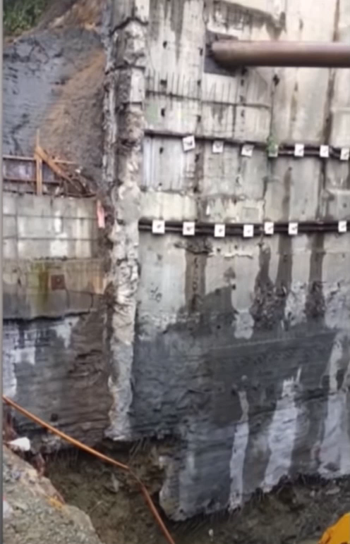
Introduction to Deep Excavations
Source: https://www.youtube.com/watch?v=Q4KrHSd7H_M&ab_channel=CatersClips
Notes:
But here’s what happens when things go wrong.
Deep excavations are complicated and dangerous and have a high-risk to life.
It’s important that they are designed and delivered to the highest possible precision and accuracy

Slide 4
Computational Models
Construction Site
Computational Model
Prediction for Future
{
Deflections
Moments
Water Levels
Complicated
Time-consuming
Low accuracy
Slow
Notes:
To achieve this high accuracy, it is common to use Computer Aided Design and Finite Element software, both forms of computational models, which I believe most of you are familiar with.
They help model and simulate the construction site and can predict future outcomes. For example:
What is the deflection in a retaining wall
What is the bending moments in this structural member,
What are the water levels likely to be 1 week into the excavation.
The list goes on. These computer models can predict just about anything.
As I’m also sure you’re aware, building and calibrating these models is complicated and time-consuming.
Sometimes, they’re also not the most accurate or reliable, or can go ‘out-of-date’ as the project progresses.
Finally, running these models and simulations can sometimes take hours
Clearly, this is a problem and can be a source of error.

Slide 5
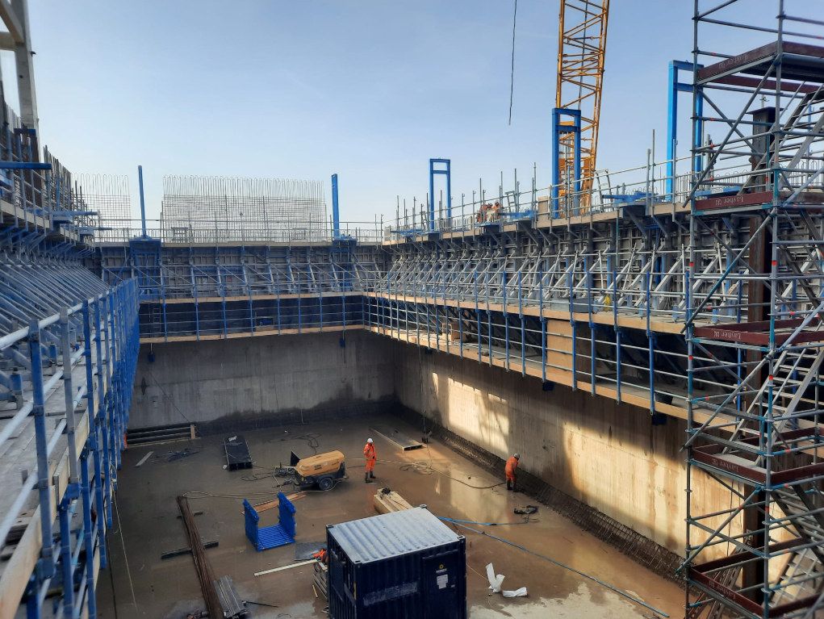


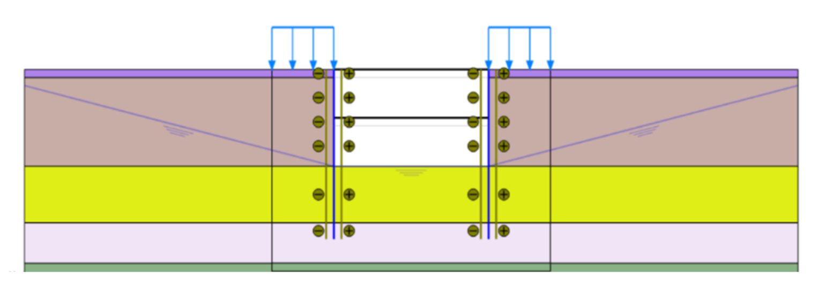
PROTOS EFW Project
Chester
Storage bunker with 11 construction stages
Plaxis2D model of site
Source: P. Hensman, Investigation of soil-structure interaction for deep excavation (2023)
Notes:
We focused on the PROTOS EFW project; a waste-processing facility combined with a power plant outside Chester.
A key stage was the excavation of a 40m long, 18m wide and 12m deep waste storage bunker.
The construction was undertaken in 11 stages, we will come back to this fact later.
Below is a Plaxis2D model which was calibrated accordingly.
For those who don’t know, Plaxis is a Finite Element program commonly used in geotechnical engineering.
The Plaxis2D Model was calibrated using site data gathered experimentally. This alone was an extensive piece of work which we build on from.
The experimental data are more accurate than simulations, but also more expensive to obtain and there isn’t much of it.
I will elaborate further.
Let’s take a better look at one quantity of interest throughout the construction process.

Slide 6
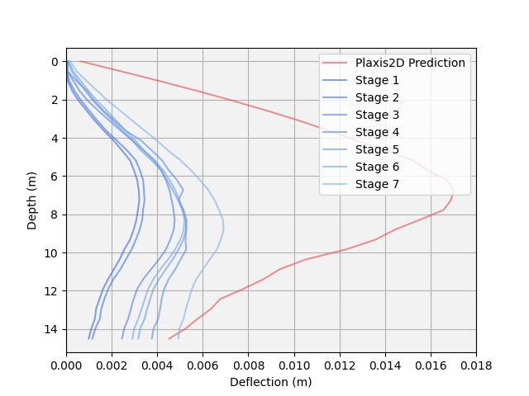
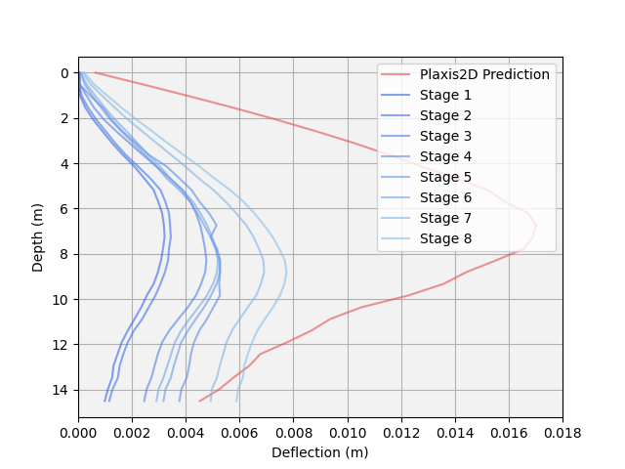
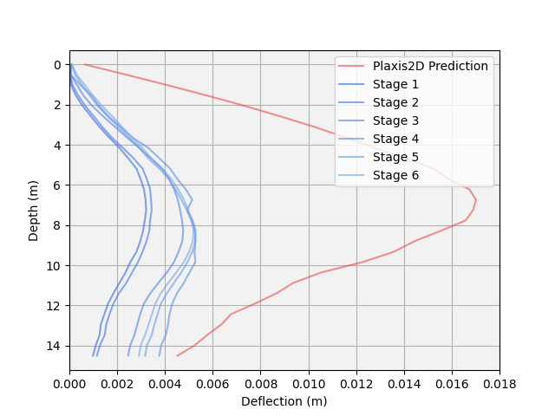
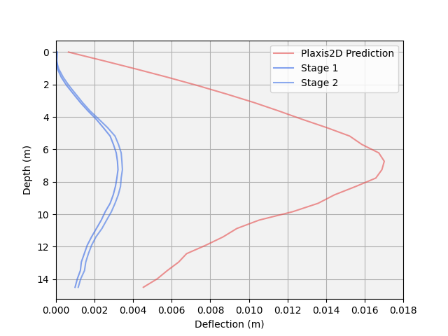
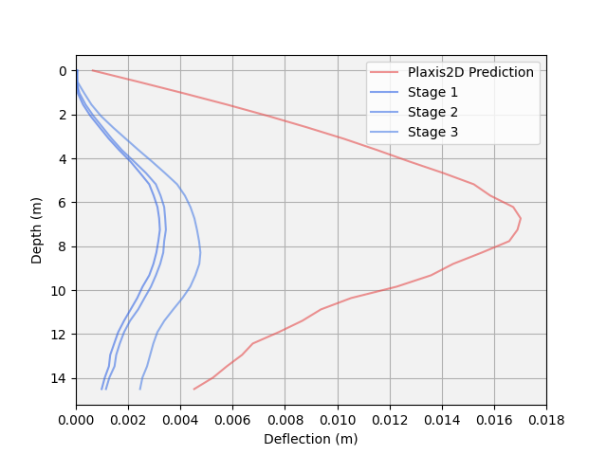
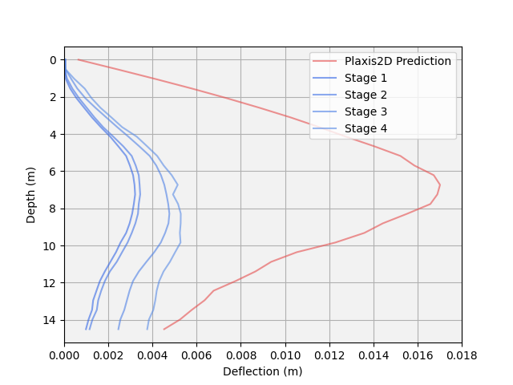
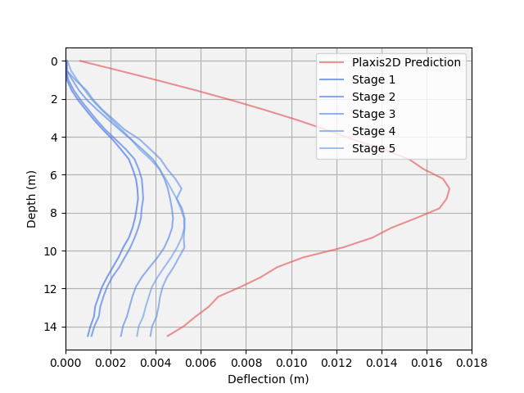
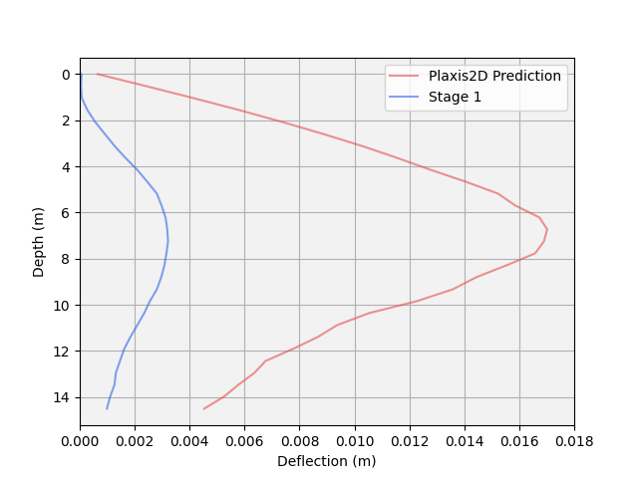
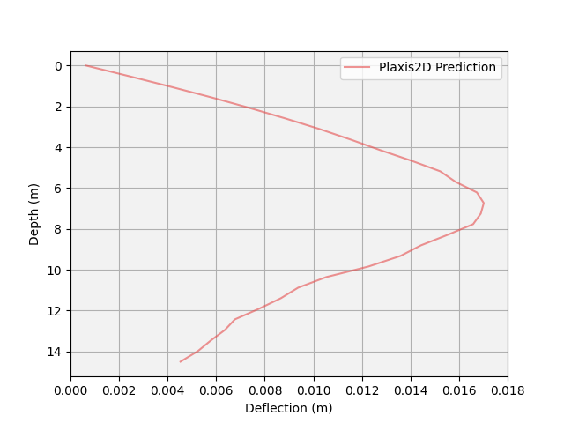
Multi-fidelity Data
Deflection profile of retaining wall over 11 construction stages
Notes:
Let’s focus on one quantity of interest, the deflection profile of the bunker’s retaining wall.
It’s important that we know how far the wall might deflect throughout the 11 construction stages to make sure safety and quality specifications are met, or that it doesn’t burst or damage nearby infrastructure.
Before we start excavating, the Plaxis model can give us a rough idea of what to expect.
Here’s the predicted final deflection according to Plaxis.
As we begin the excavation, we measure the deflection at each construction stage.
Here are the first few shapes, stage 1, stage 2 and so on.
So, what might the final, real deflection shape look like?
Typically, you would base your estimates off either the computer simulation or the site data.
What if we could combine both of them? Could we learn something useful from both datasets and get the best prediction possible?
This is the concept of multi-fidelity learning.
The best tool for such are artificial neural networks, a subset of machine learning.
For brevity, we won’t dive into these too extensively, but know that they are highly competent at mapping complex inputs to the desired outputs.

Slide 7
Methods
Low-fidelity Plaxis2D data
}
Dataset size
Accuracy
Multi-fidelity
Neural Network
Multi-fidelity prediction
Accuracy
High-fidelity site data
Accuracy
Dataset size
Notes:
So, to recap, we want to use both the low-fidelity Plaxis2D inputs,
The high-fidelity experimental site data,
And combine them using our multi-fidelity neural network,
To hopefully achieve better predictions than if we were to use only one of those two by itself.

Slide 8
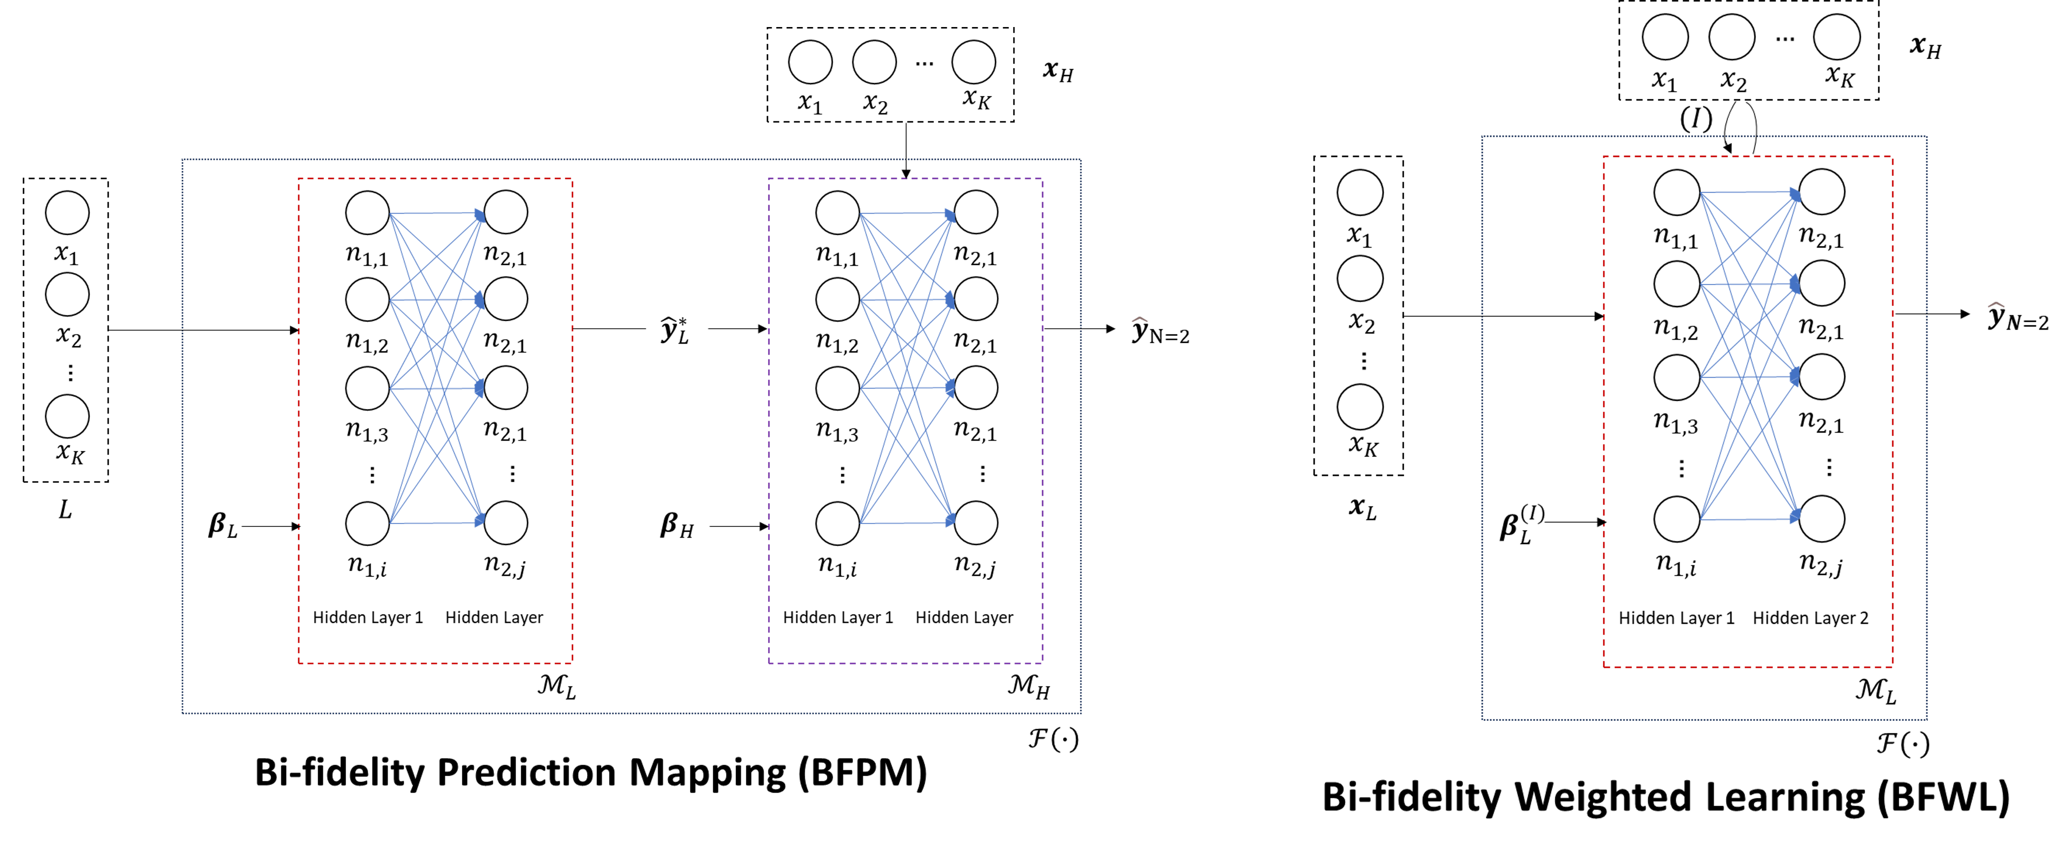
Multi-fidelity Neural Networks
Notes:
What does this MFNN look like?
We take the low fidelity data,
And pass it through a low fidelity model,
To get a low-fidelity prediction,
Next, we take the high-fidelity data,
And train this new, high-fidelity model on both the high-fidelity data, and the prediction from the low-fidelity model.
From here, we can get the bi-fidelity (as this uses two degrees of fidelity) prediction.
We call this technique bi-fidelity prediction mapping.
Moving on to the results.

Slide 9
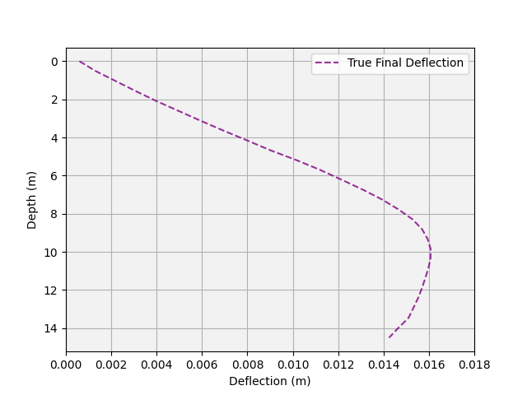
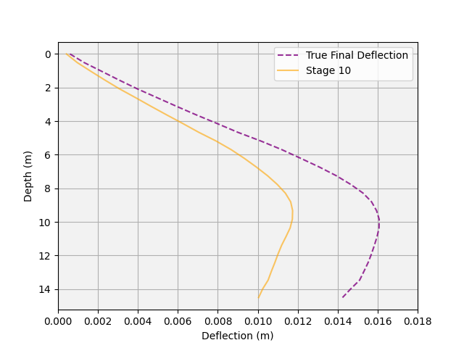
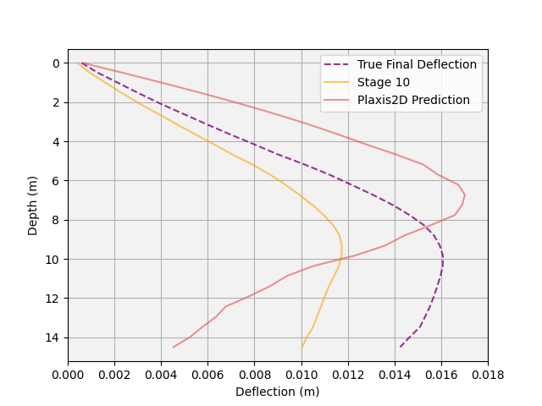
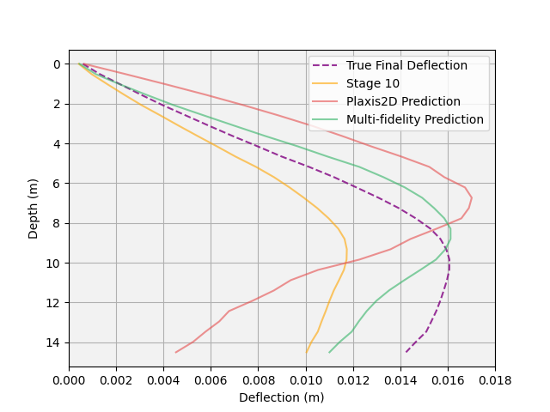
Results
Notes:
We take a look at the results.
Let’s see how this multi-fidelity method compares to the usual prediction methods.
First, we plot the true final deflection. This is what we’re trying to predict with our multi-fidelity approach.
Next, we have the stage 10 deflection. This is the most recent high-fidelity experimental point we have.
Notice how it’s quite far away from the true final shape, so if we were to base our prediction entirely off that, we might still be a bit off.
Next, we have the Plaxis2D prediction, the same one we had before.
Close, but not quite. There’s room for improvement.
Finally, we have the multi-fidelity prediction.
Clearly the best one so far.
By combining these two, we come to a more accurate prediction for the final deflection shape. Success!

Slide 10
Conclusions
Impact of project:
Combined site data with simulation data using a multi-fidelity neural network
Better and faster predictions than existing methods
Leads to safer excavations
Future work:
Use another level of fidelity, such as from a Plaxis3D model
Investigate how we could move this from site to site
Notes:
Read
Methods such as 2D Plaxis simulations or predictions based on previous site work
Better and faster predictions lead to more informed on-site-decision making and ultimately, safer excavations

